Slide 1
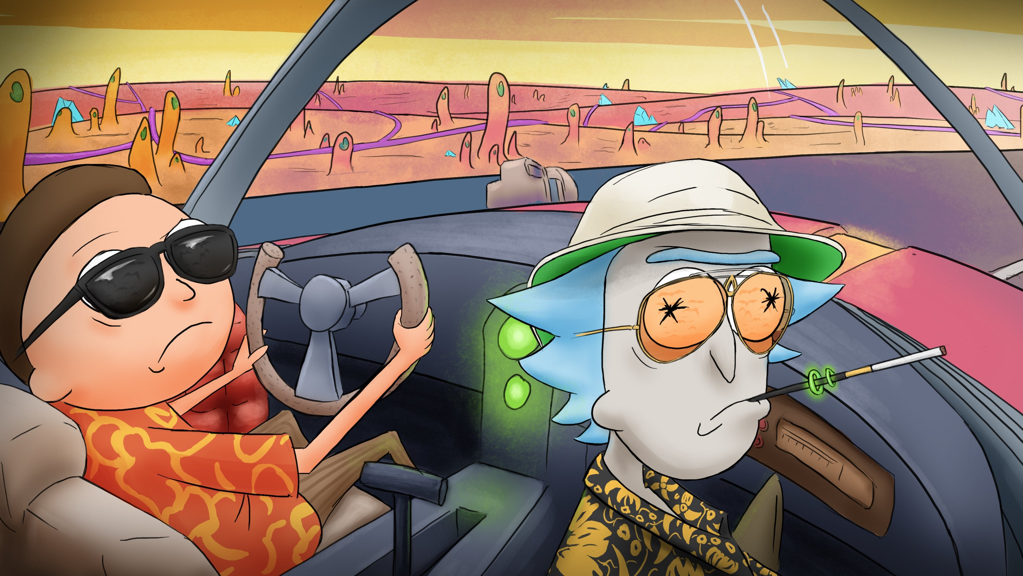
Recursion
Recursion
Recursion
Recursion
Prof. Darrell Long
CSE 13S
“We can't stop here, this is bat country!” —Hunter S. Thompson, Fear and Loathing in Las Vegas
© 2020 Darrell Long

Slide 2
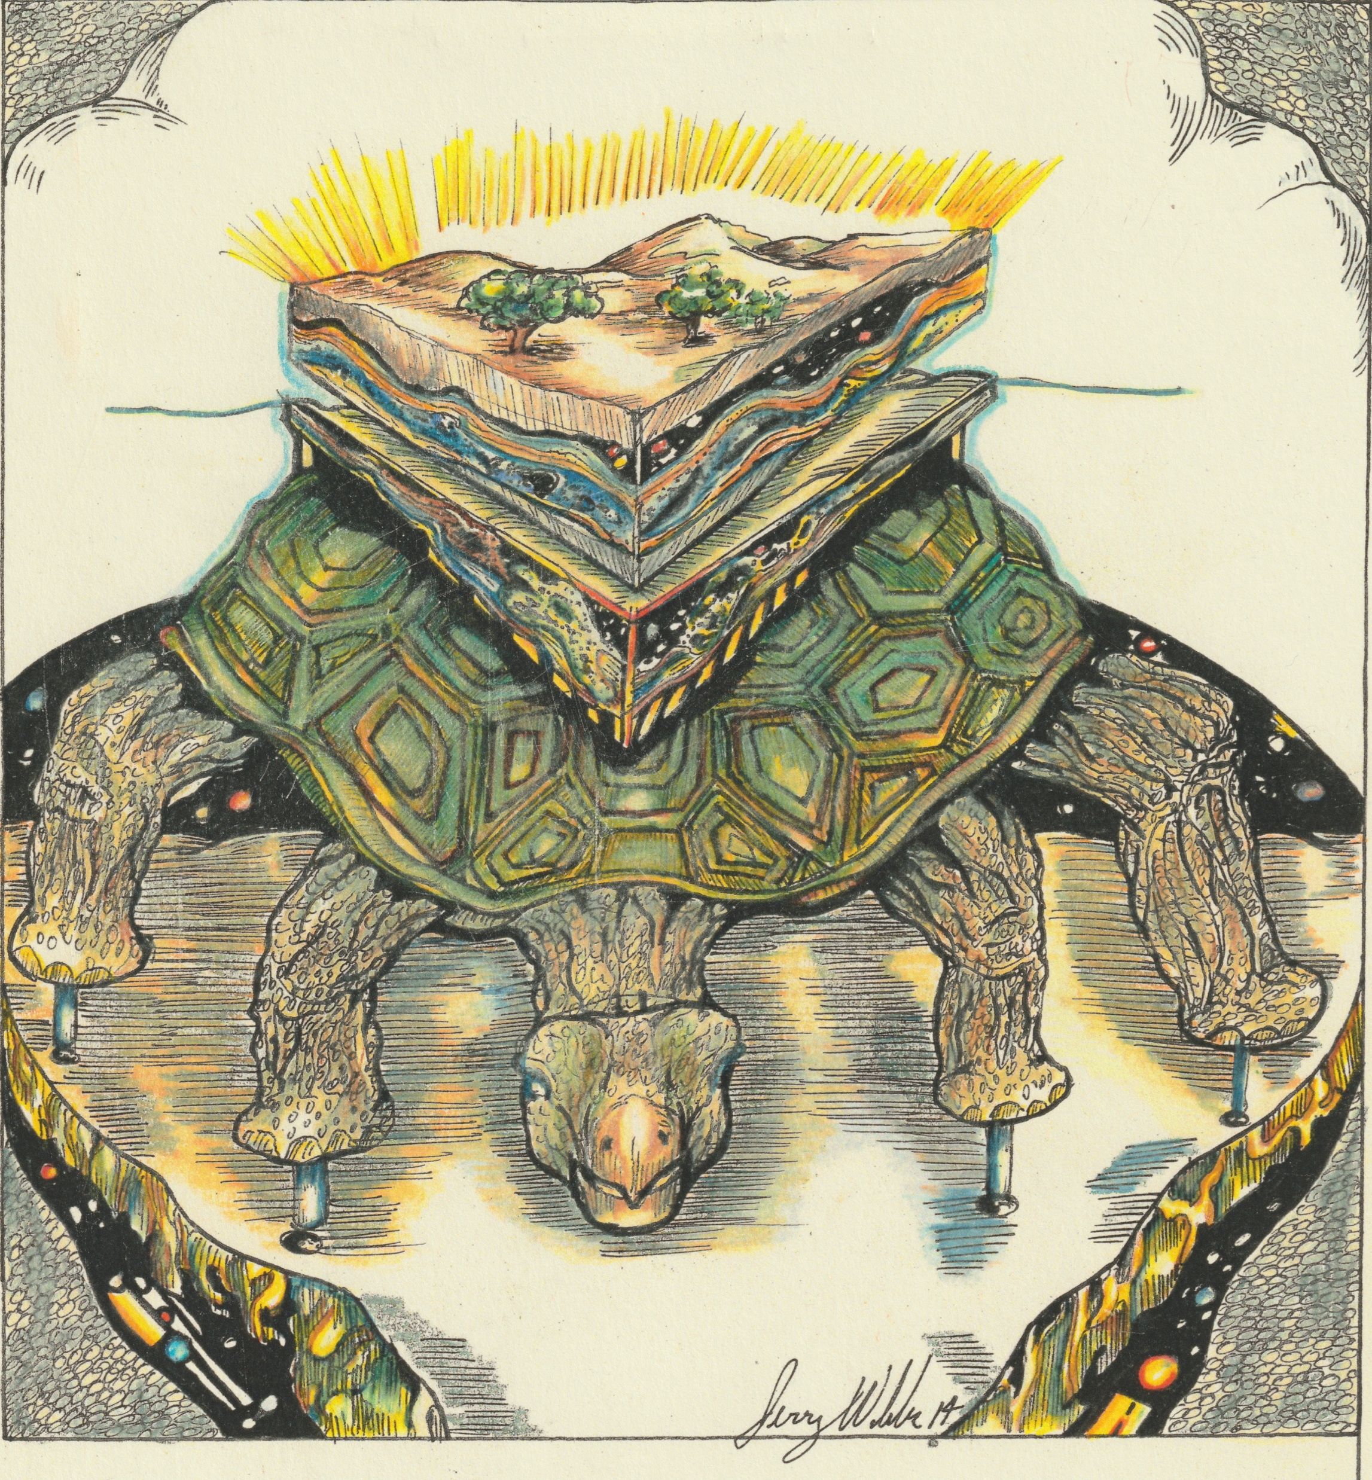
A recursive function is defined in terms of itself.
ln our favored version, an Eastern guru affirms that the earth is supported on the back of a tiger. When asked what supports the tiger, he says it stands upon an elephant; and when asked what supports the elephant he says it is a giant turtle. When asked, finally, what supports the giant turtle, he is briefly taken aback, but quickly replies “Ah, after that it is turtles all the way down.”
—Antonin Scalia
© 2020 Darrell Long

Slide 3
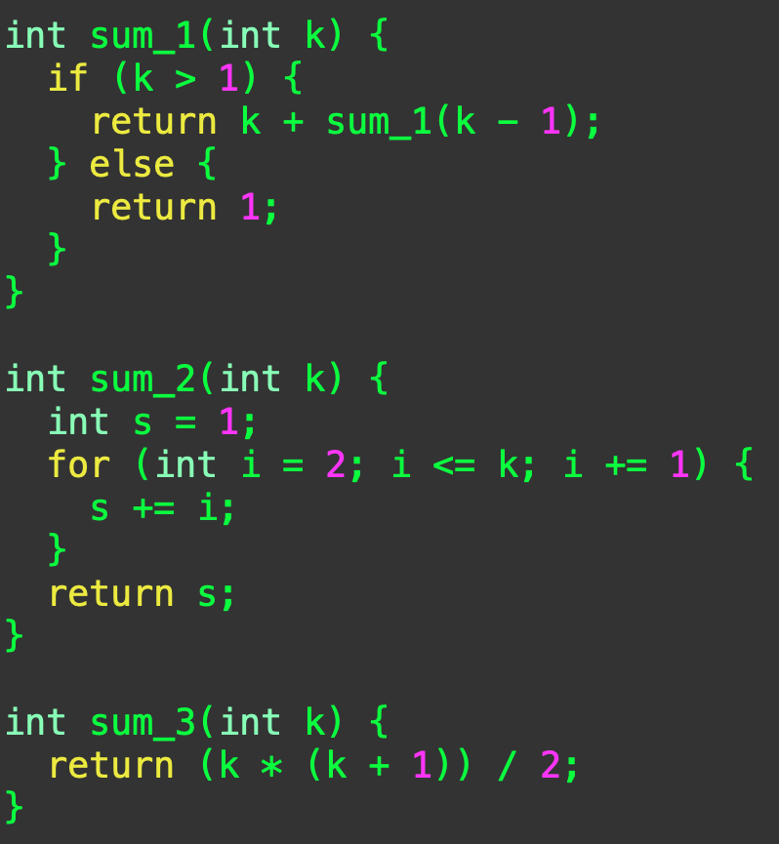

Let’s sum the first k natural numbers
$∑k=k+∑\left(k−1\right)$ and
$\sum{1=1}$, or
We can loop through and add them up, or
We can use Gauß’s formula.
The first of these is recursive, since it is defined in terms of itself.
© 2020 Darrell Long

Slide 4
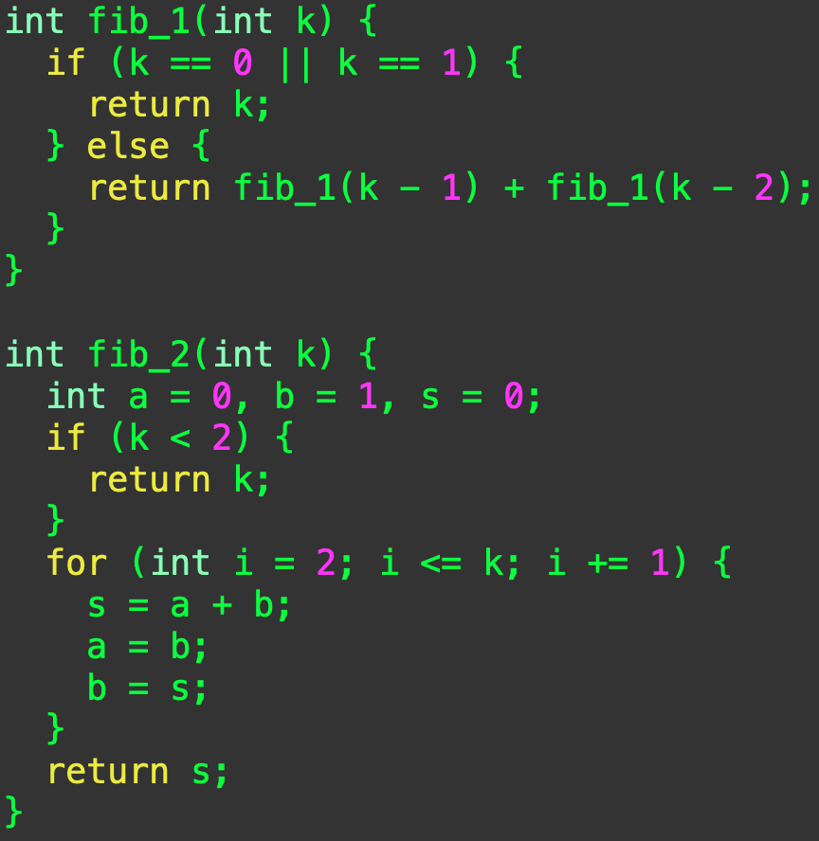

Fibonacci numbers
In this case, both algorithms compute the same value.
The first algorithm is recursive and runs in $O(2^{n})$ time.
The second algorithm is iterative and runs in $O(n)$ time.
© 2020 Darrell Long

Slide 5
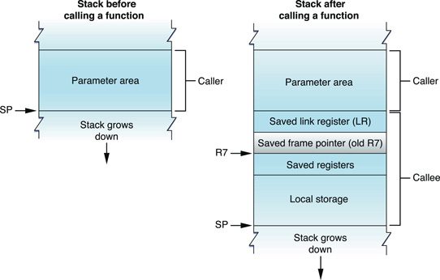
Are recursive algorithms inherently inefficient?
The short answer is no…
The real answer is more subtle:
A function call requires creating a stack frame, and that takes time and space.
All tail recursive functions can be rewritten as iteration (often by the compiler).
© 2020 Darrell Long

Slide 6
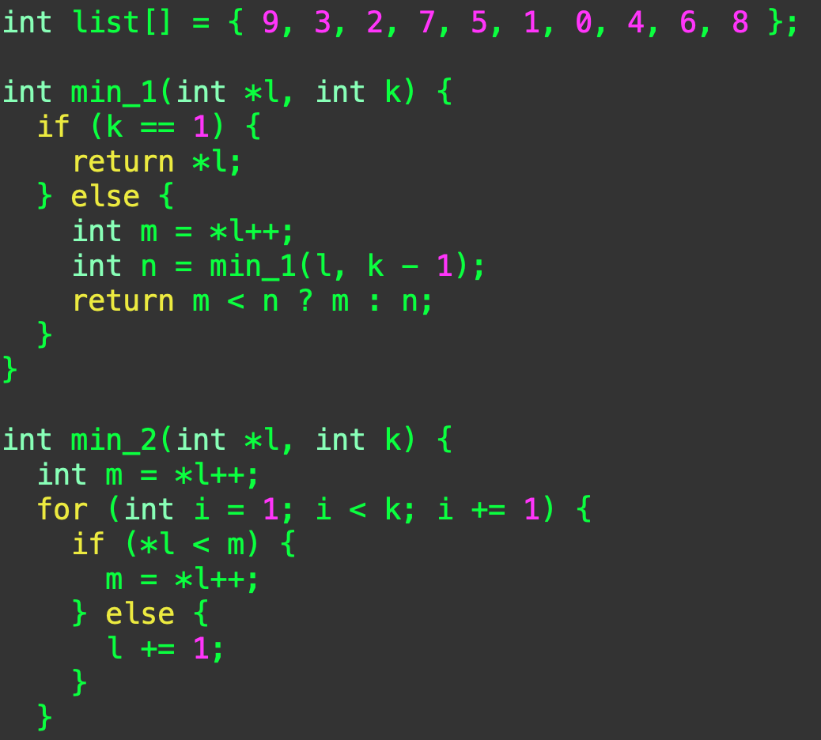

So when do I use recursion?
The answer is simple: when it makes sense.
Use recursion when it is natural for you to express your algorithm recursively.
Do not use it when it does not make the code clearer!
© 2020 Darrell Long

Slide 7
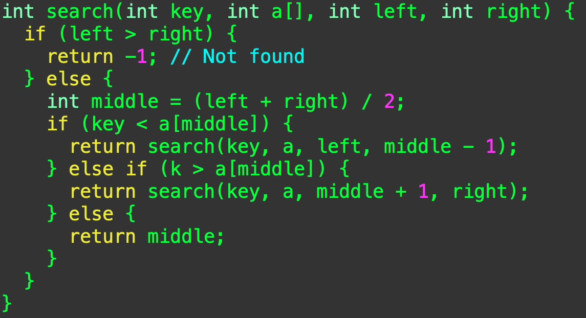

Binary Search
We can search an ordered array in $O\left(log\left(n\right)\right)$ time.
If the list is empty, then it is not there.
If the key is smaller, look in the left half;
If it is larger then look in the right half.
You can also do this iteratively!
© 2020 Darrell Long

Slide 8


How fast can we search?
Binary search is as fast as we can go.
What about slicing it into three parts? Or 10?
It’s still $O\left(\log\left(n\right)\right)$, just with a different constant.
Remember: binary search requires that the array be sorted.
© 2020 Darrell Long

Slide 9
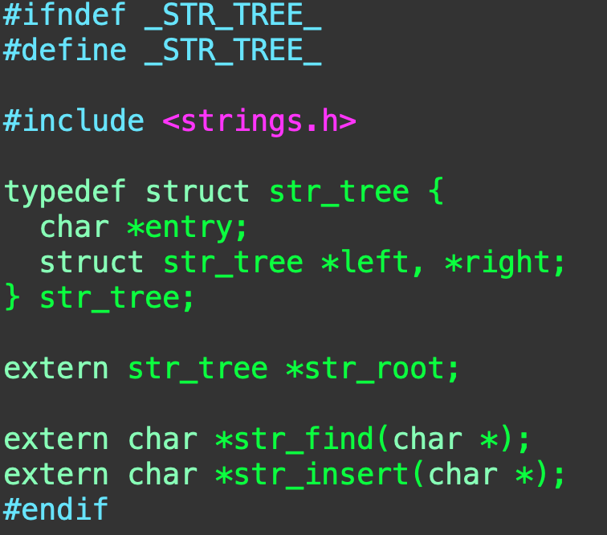
String Table
Suppose that I want to efficiently store strings so that I only have a single copy of each one.
Why would I want to do that?
Compilers have to keep track of a lot of strings (variable names, for example).
© 2020 Darrell Long

Slide 10
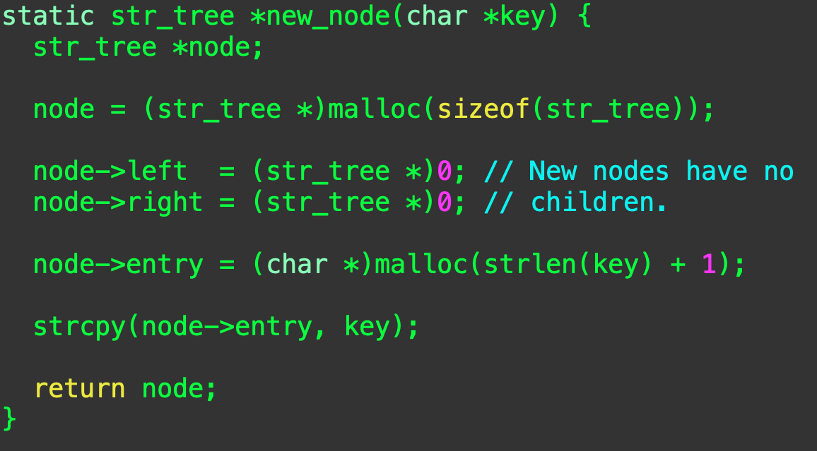
new_node()
Allocate a node,
Set the children to NULL,
Make room for the string,
Copy the string.
Did he really just use strcpy()?
Bad!
© 2020 Darrell Long

Slide 11
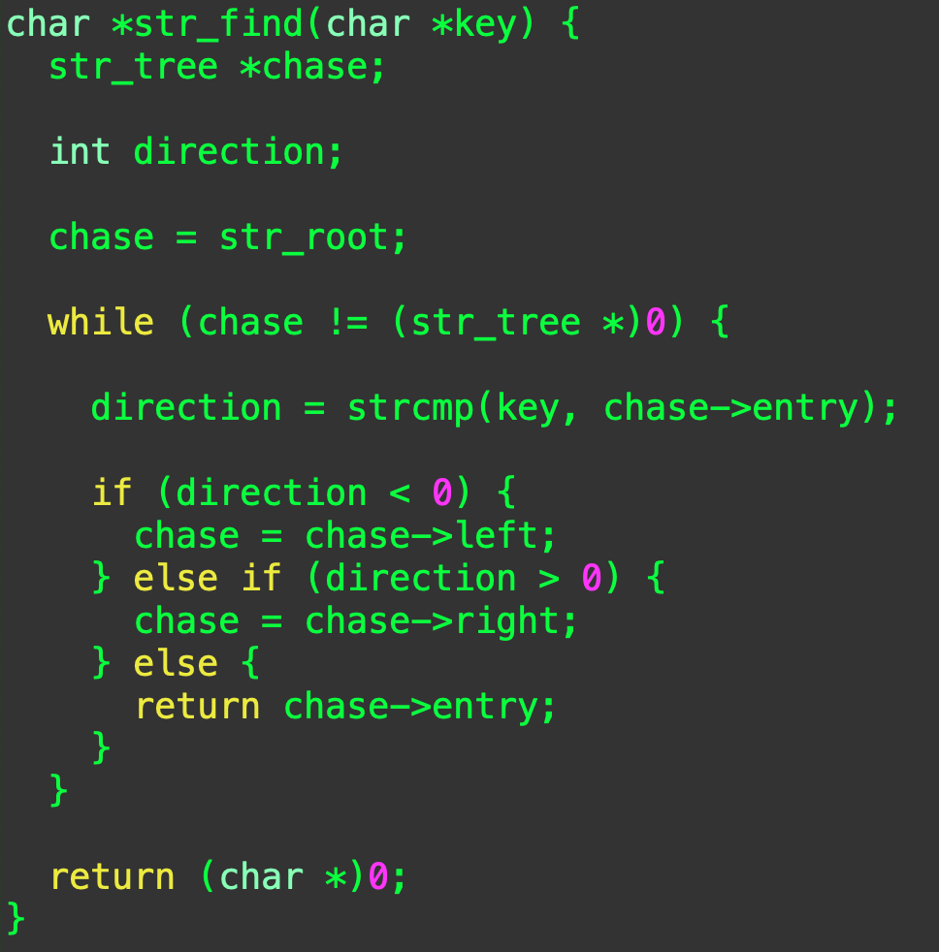
str_find()
Start at the root.
Are we done?
What does strcmp() say?
Go left?
Go right?
There it is!
Oops, did not find it.
© 2020 Darrell Long

Slide 12
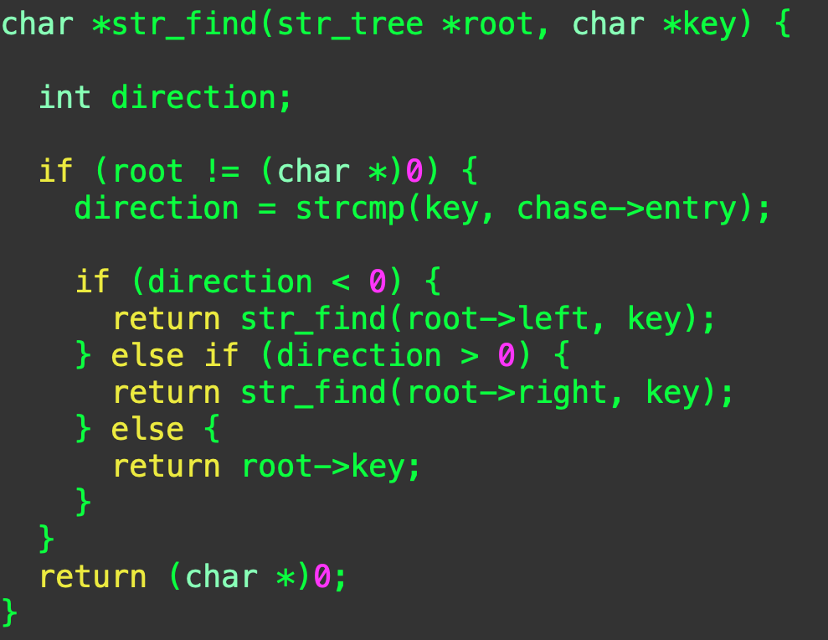
A recursive alternative
If we’ve reached the leaves, then it isn’t there.
What does strcmp() say?
Recurse left?
Recurse right?
There it is!
© 2020 Darrell Long

Slide 13
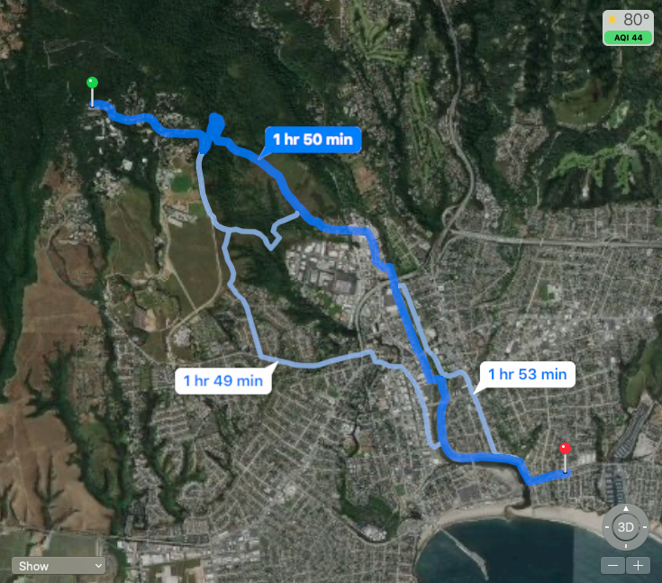
Recursion is natural for search
We use recursion for searching by dividing the space up:
Places we have searched, and
Places we have yet to search.
If we get stuck, we can back up and try a different path.
For example, we want to find the shortest path from E2 to Betty Burgers.
© 2020 Darrell Long

Slide 14
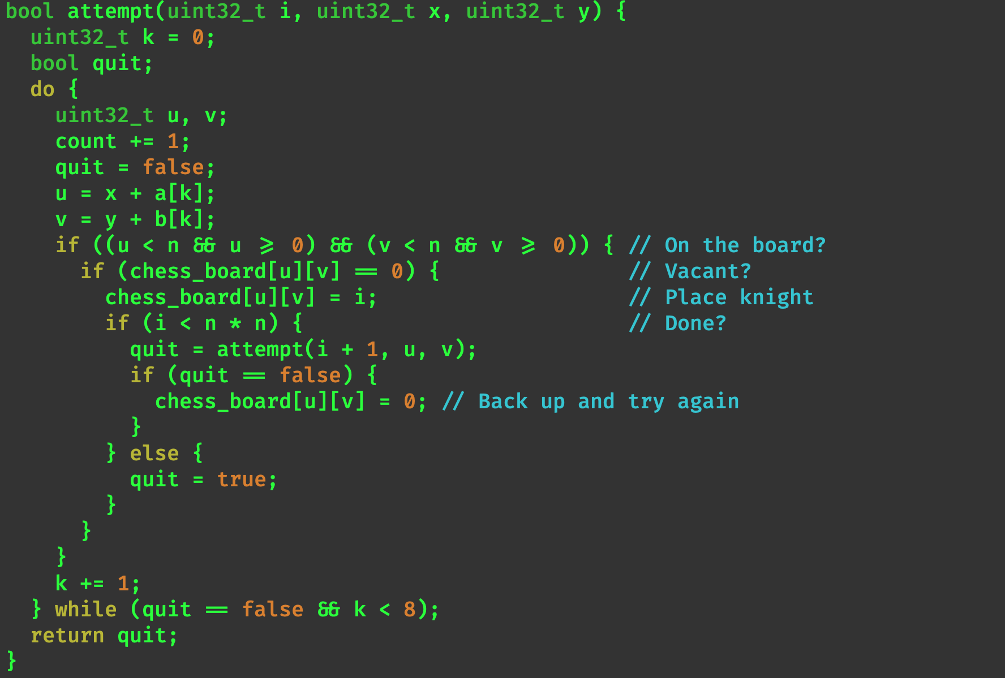
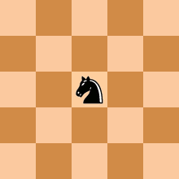
The Knight’s Tour
Can a knight visit all of the squares on a chess board exactly once?
This is a form of a Hamiltonian path problem.
© 2020 Darrell Long

Slide 15
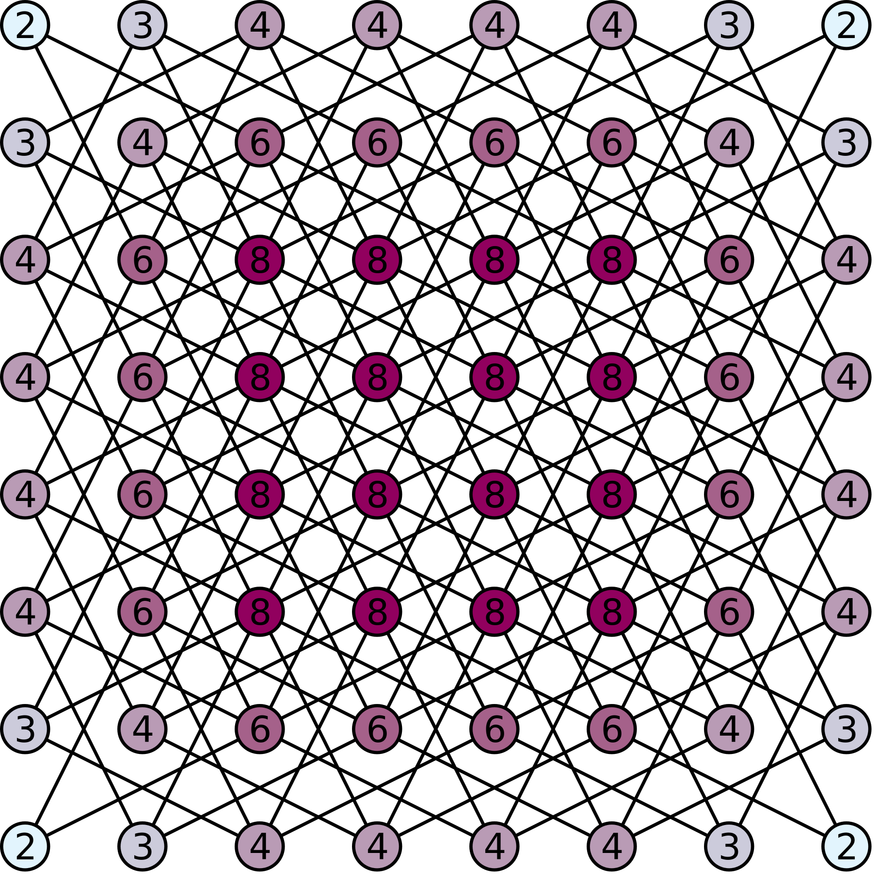
How many possible moves?
There are 26,534,728,821,064 directed tours on an 8 × 8 chess board.
© 2020 Darrell Long

Slide 16
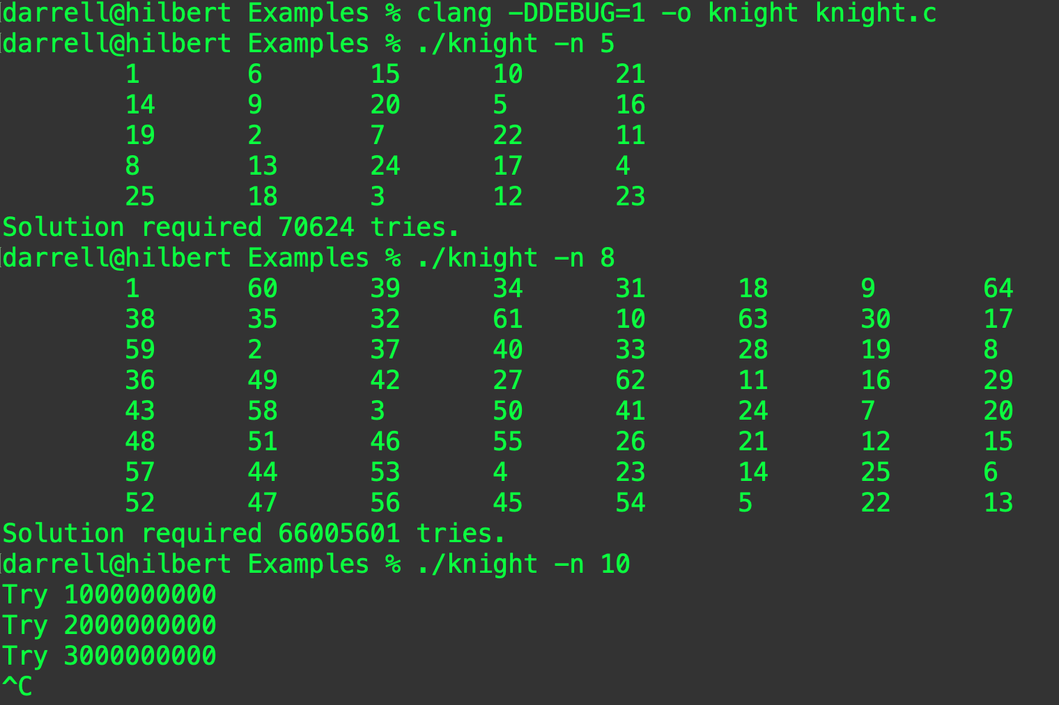
Let’s try it!
Perhaps not!
© 2020 Darrell Long

Slide 17
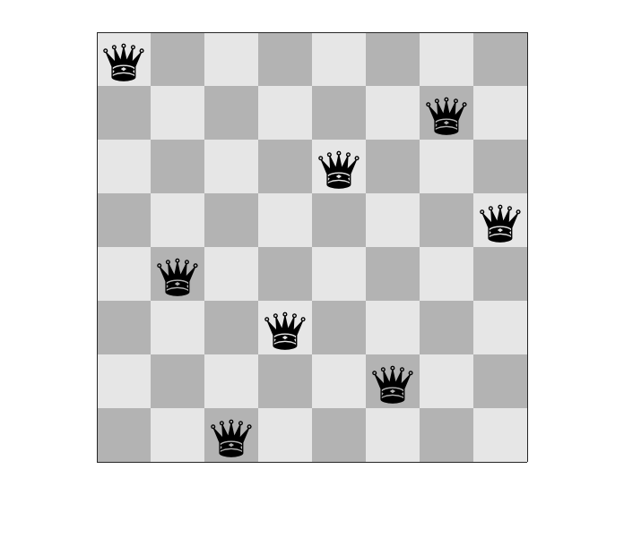
Eight Queens
Can we place eight queens on a chess board so that none threatens the others?
There are 92 solutions for an 8 × 8 chess board.
Larger boards have more solutions.
What is the expected run time of this problem?
Number of solutions for n × n, starting with n = 1:
1, 0, 0, 1, 2, 1, 6, 12, 46, 92, 341, 1787, 9233, 45752, 285053, 1846955, 11977939, 83263591, 621012754, 4878666808, 39333324973, 336376244042, 3029242658210, 28439272956934, 275986683743434, 2789712466510289, 29363495934315694
© 2020 Darrell Long

Slide 18
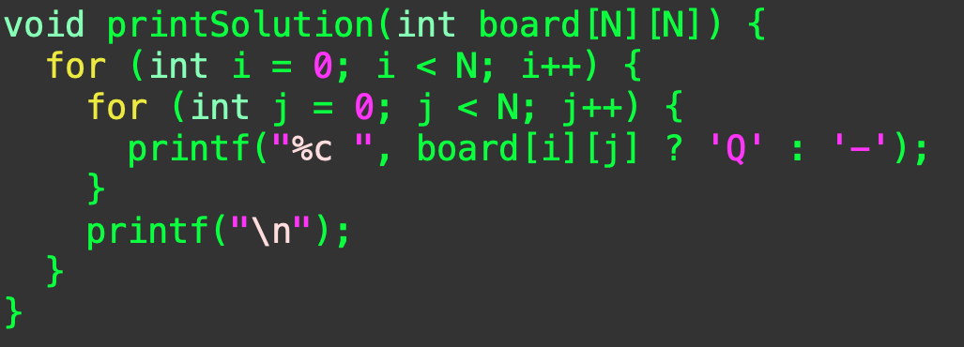
Print the Board
Solution due to Niklaus Wirth & Deepank Pant
© 2020 Darrell Long

Slide 19
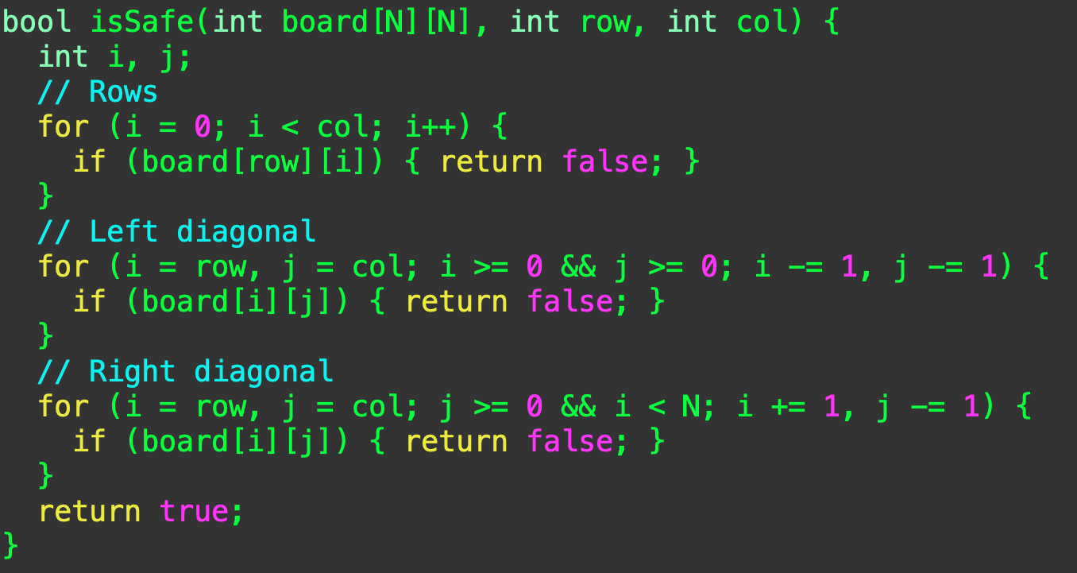
Is this position safe?
© 2020 Darrell Long

Slide 20
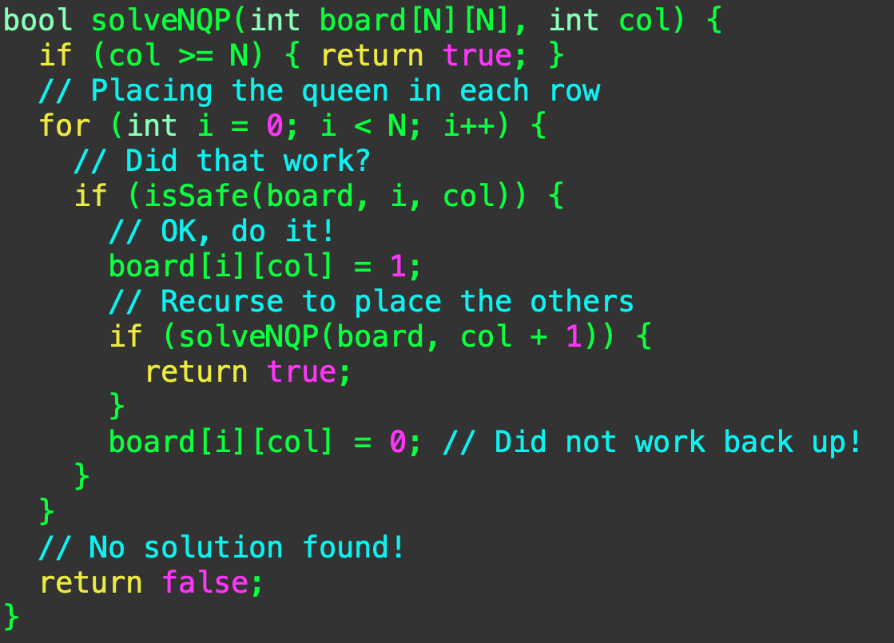
Search for the solution
© 2020 Darrell Long

Slide 21
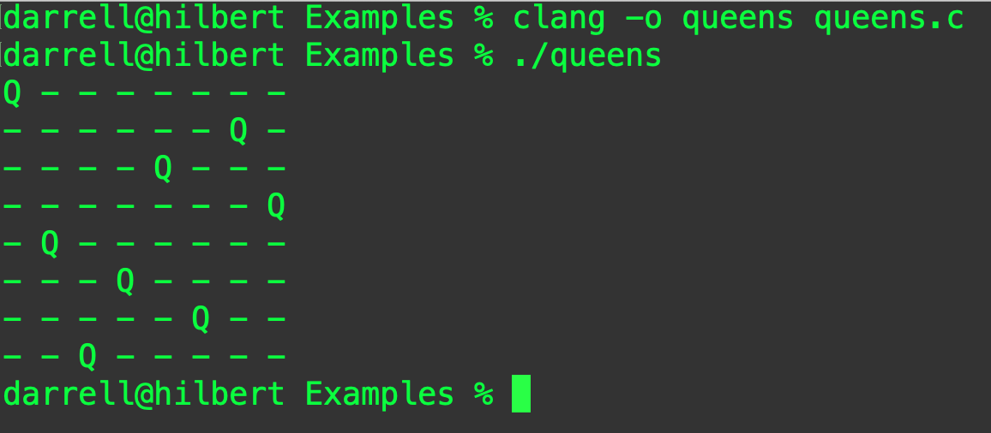
Did it work?
© 2020 Darrell Long

Slide 22

What did we learn?
Recursion is natural.
It is good for search problems.
It is not inherently inefficient.
Like all tools and techniques, use it where it makes sense.
© 2020 Darrell Long

